Slide 1

ELEC5566M-FPGA Design for System-on-chip Mini-Project – Color Game
Name: Yucheng Lin
Student ID: 201580282
Notes:
Hi, im Yucheng Lin. The mini project is to create a game, color game.

Slide 2
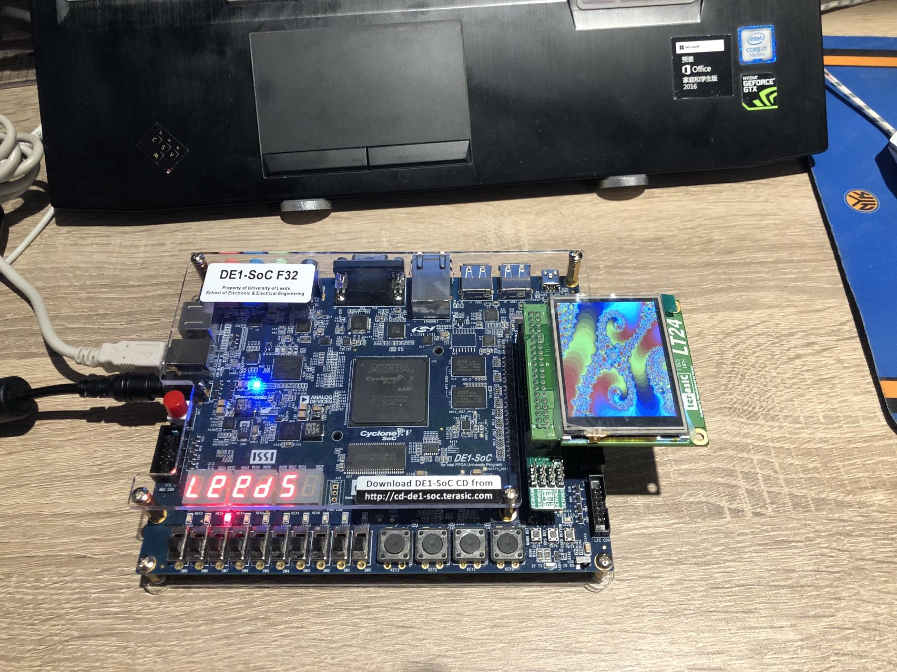
Mini-Project
LT24 LCD module
Introduction
Game Rules
Testing & Result
Conclusion
DE1-SoC Board
Notes:
The aim is to program the DE1-SoC development board and the LT24 LCD module. The presentation was divided into four parts: introduction, Game rules, testing and conclusion. In Figure, that part is the DE1 board and the smaller one is the LT24 LCD module.

Slide 3

Introduction – Color Game
DE1-SoC board
- Control and operating system
(LED, Switch, Key, 7-segment display)
LT24 LCD module
- Displaying 240x320 images
Figure 1: The cover of game
Notes:
The Color game is controlled by the DE1 board, mainly using LED lights, switches, buttons and 7-segment display. Then, the game screen is displayed on the LT24 LCD module according to the corresponding control, and only can display 240 by 320 images. On the right is the cover of the game.

Slide 4
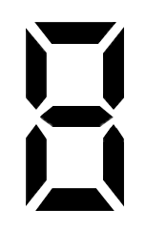



Game rules – 3 steps
1
2
Start
Countdown timer (set for 15s)
Scoreboard
Highest Score Recorder
Switch_0
The cover of game
3
Key_0
The three game screens switch randomly, but when the right button is pressed
Reset
Game Over
Switch_9
When the timer reaches 0
Key_3
Key_2
Key_1
Clear the highest record
Press the corresponding button to add points
Notes:
Next are the rules of the game. First is the game cover, where the player can see three colors on the screen, each color corresponding to a button. When the player turns on SW0 the game starts and will go to the second step which is the game phase. The timer will start counting down and the player will press the buttons according to the color that appears on the screen. If the wrong button is pressed, the screen will not jump to the next one until the correct button is pressed and the score is added. The scoreboard will record how many times the player can press the correct button in 15 seconds. If the player has the highest score, the highest record is recorded. When the timer reaches 0, the screen stops jumping and the game is finished. Only the reset button can be pressed. However, only SW_9 can clear the highest record.

Slide 5
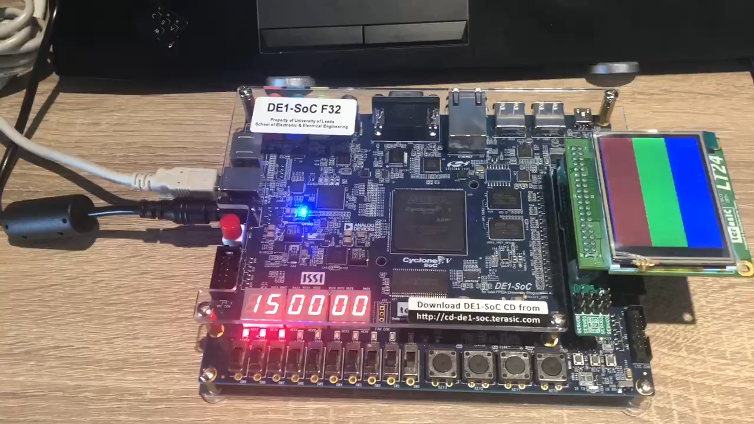
Testing & Result
Scored 8 points in 15 seconds !
Notes:
Now showing how the game works in the video.

Slide 6
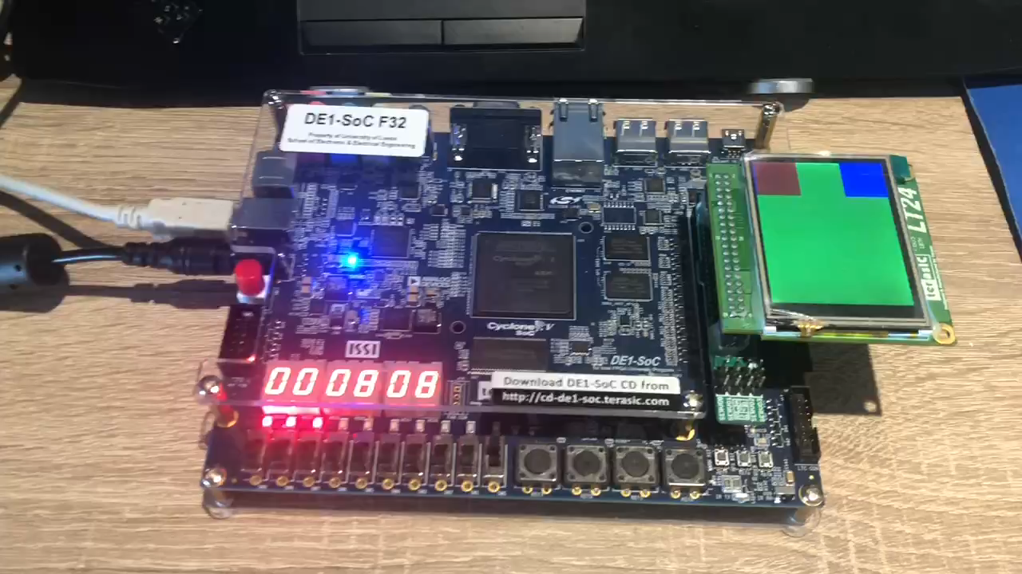
Play again and try to refresh the highest record and clear the highest record
22 points !
Try to beat me !!!

Slide 7
Conclusion
Two State Machine
- Game state machines
- Color state machines
Countdown Timer module – 1 second
- Countdown in seconds via clock
Score module
- Ability to record scores
- Ability to record Highest score
LT24 LCD module
-The game graphics could be richer in
Notes:
The test results were successful. Two state machines were used in the design of the game, the game and the color state machine. Among them, three modules were programmed on the system. A countdown module in seconds was created by means of a clock. The score module was used to record the score and the highest score. Finally, there is the LT24 module which is used to display the game screen. In the future, it is possible to try to make the game scenes even richer.

Slide 8
Thank you

Slide 9
Green_STATE
Reset
cover_STATE
Red_STATE
Blue_STATE

